Slide 1
Academy Lab Projects – Showcase
Mostafa Ahmed Tantawy
AWS Web Application Project

Slide 2
Phase 1

Slide 3
Business scenario overview
Problem Statement :
This project requires an understanding of core AWS services, such as compute, storage, networking, and database services. The project also requires knowledge of architectural best practices, such as high availability, scalability, and security. Students should have completed the AWS Academy Cloud Architecting course to gain this necessary knowledge. Students who have completed the AWS Academy Cloud Foundations course and are enrolled in the AWS Academy Cloud Architecting course can also try to complete this project with the help of course materials, labs from courses, and educator guidance. Knowledge of any programming language, such as Python or JavaScript, is an advantage but isn’t mandatory.
Your Scenario is to plan, design, build, and deploy the web application to the AWS Cloud in a way that is consistent with best practices of the AWS Well-Architected Framework. During the peak admissions period, the application must support thousands of users, and be highly available, scalable, load-balanced, secure, and high performing.
The current web application slows down or becomes unavailable during peak admissions due to high traffic.

Slide 4
Business scenario overview
Solution requirements:
Performance: Ensure fast and reliable access during peak times.
Availability: Minimize downtime with high availability.
Scalability: Handle thousands of users via auto-scaling.
Security: Protect sensitive student data with strict security measures.
Cost Efficiency: Optimize costs with AWS pricing models
Functional :The solution meets the functional requirements, such as the ability to view, add, delete, or modify the student records, without any perceivable delay.
Load balanced : The solution can properly balance user traffic to avoid overloaded or underutilized resources.

Slide 5
Solution overview
We deploy an Application Load Balancer (ALB) to route traffic efficiently and ensure high availability.
We set up an Auto Scaling Group to automatically adjust the number of instances based on traffic, ensuring optimal performance.
For the database, we use Amazon RDS for a managed, scalable, and secure solution with automated updates.
For development, we utilize AWS Cloud9, providing an integrated environment for easy coding and collaboration.
To ensure instances in the private subnets (Auto Scaling Group) have internet access, we deploy a NAT Gateway.

Slide 6





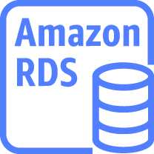

AWS Icons
EC2 Instance
Application Load Balance
Nat Gateway
Internet Gateway
Secrete Manager
AWS RDS
AWS Cloud9
Secrete role

Slide 7
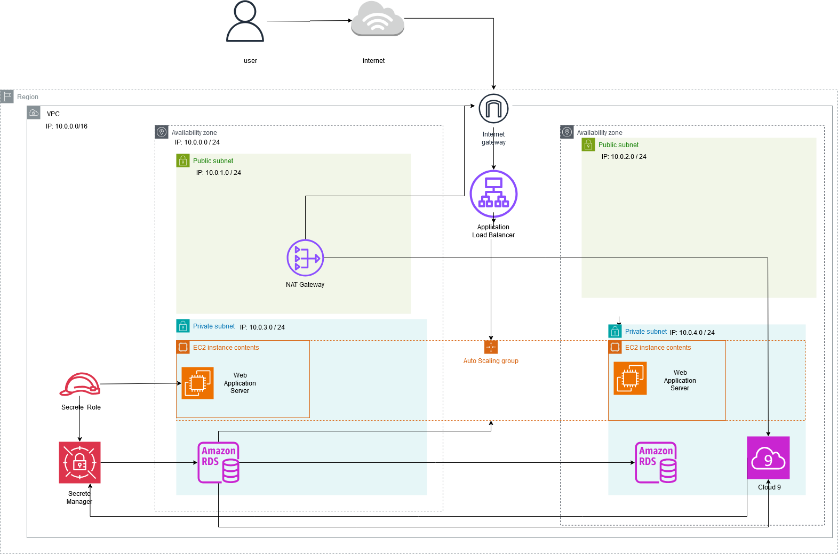
Architecture diagram of the solution

Slide 8
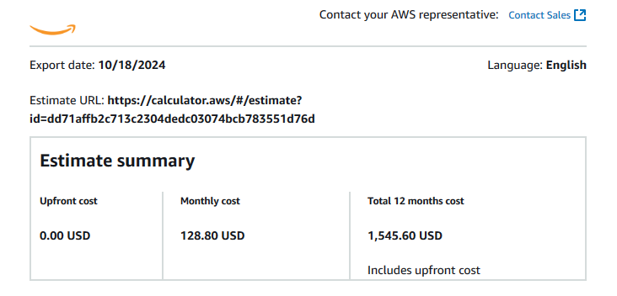
Cost Analysis

Slide 9
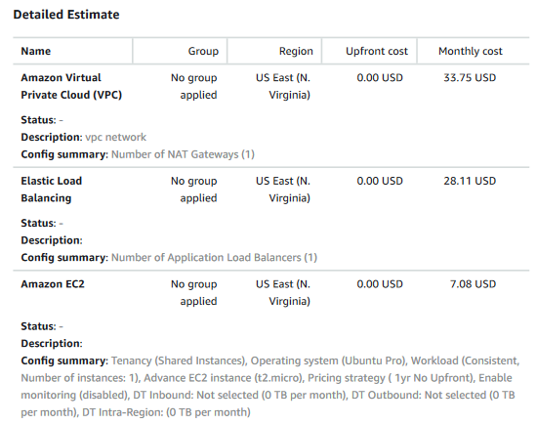
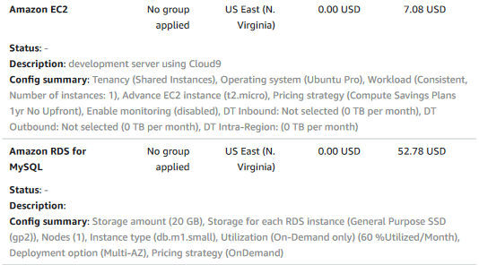
Cost Analysis

Slide 10
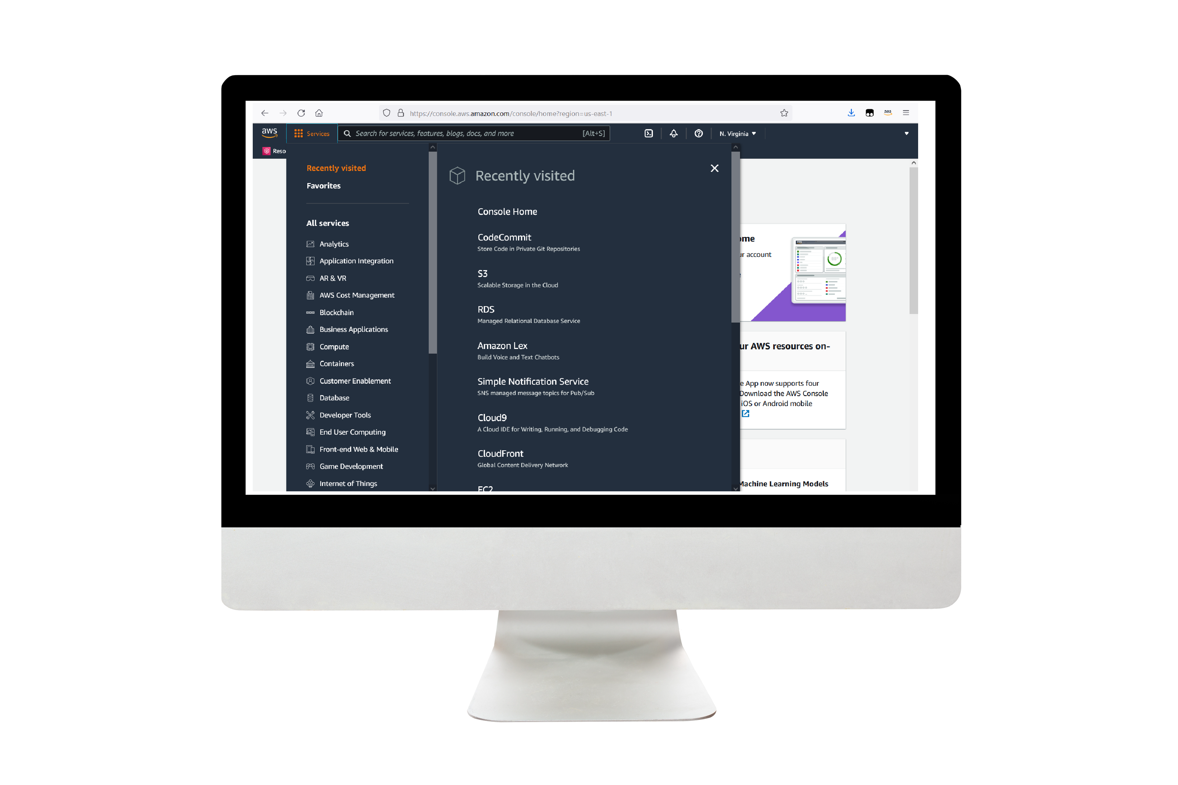
Demo
The Link of Diagram
The Link of Calculation

Slide 11
Lessons learned
Handling High Traffic: Implemented auto scaling to manage unpredictable traffic surges during peak admissions.
Database Management: Migrated to RDS for seamless scaling and automated updates without downtime.
Security Setup: Configured IAM roles, NAT Gateway, and VPC to ensure secure internet access and resource isolation.

Slide 12
Project Steps

Slide 13
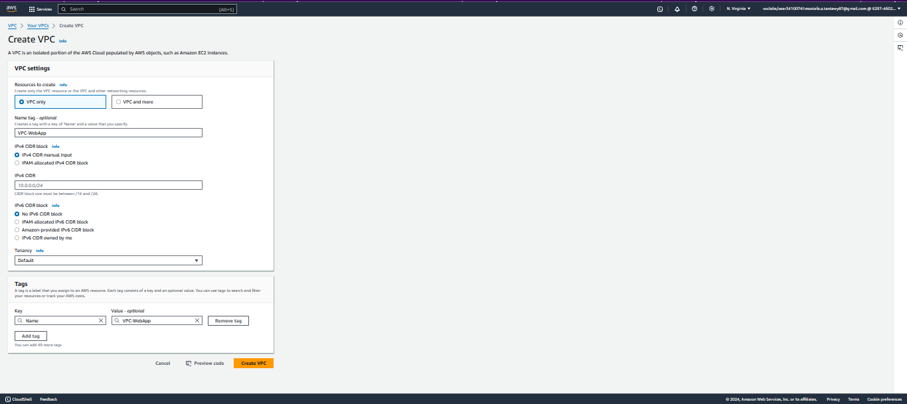
Project Steps
1- Create VPC

Slide 14
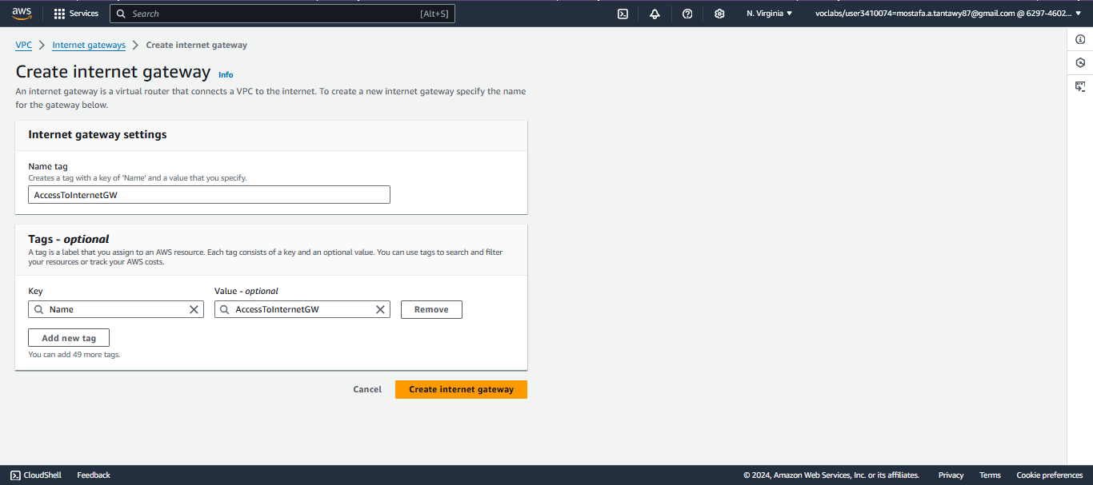
Project Steps
2- Create Internet GW

Slide 15
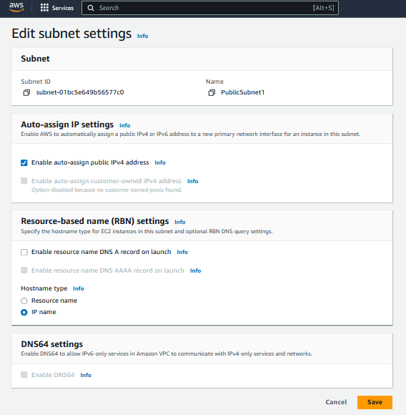
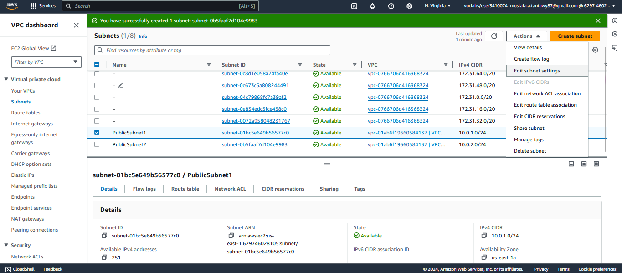
Project Steps
3- Create PublicSubnet1&2

Slide 16
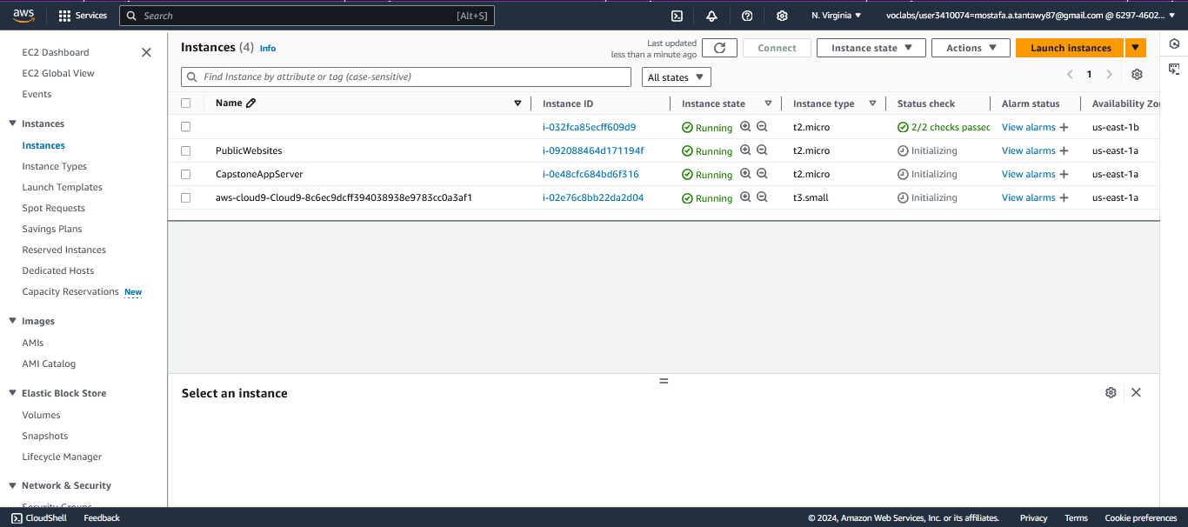
Project Steps
4- Create EC2 Instance, AWS Cloud9, CapstoneAppServer

Slide 17
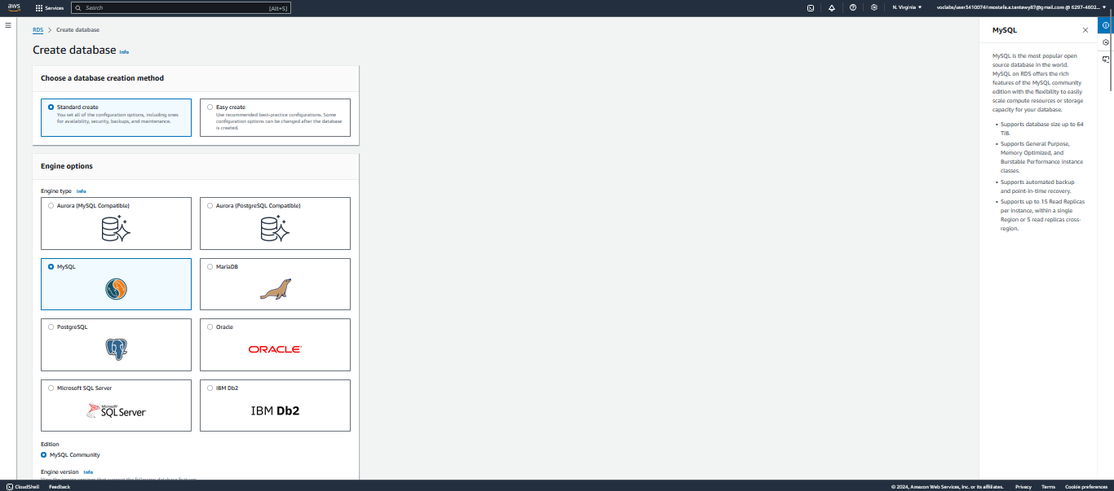
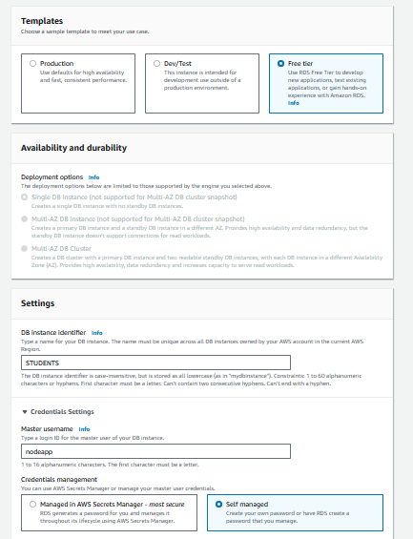
Project Steps
5- Create Database

Slide 18
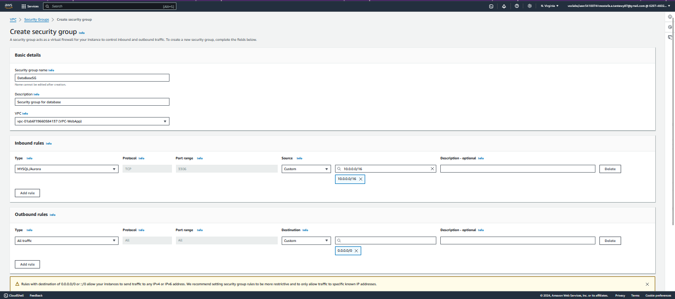
Project Steps
6- Create Security Group For RDS

Slide 19
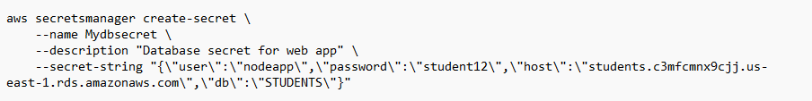
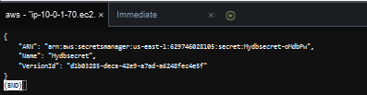
Project Steps
7- Create AWS Cloud9

Slide 20
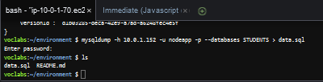
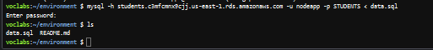
Project Steps
8- Migrate EC2 data to RDS

Slide 21
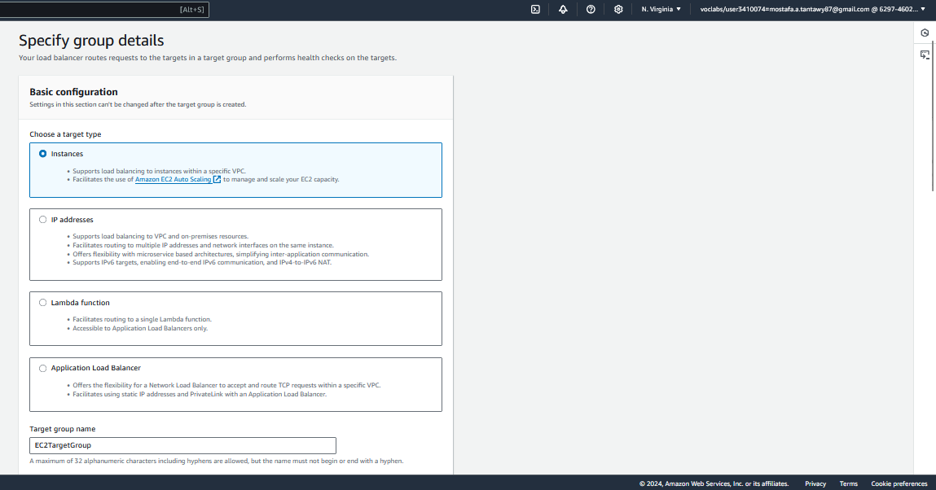
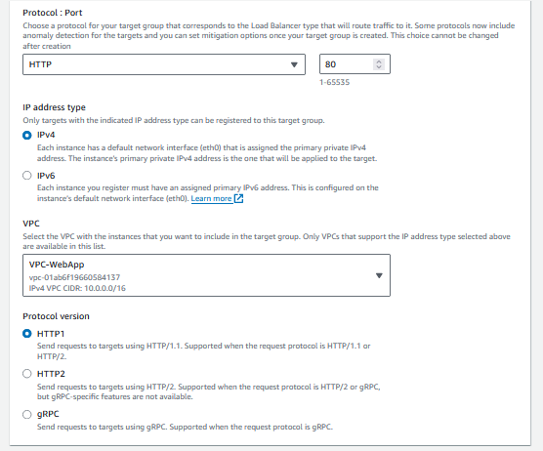
Project Steps
9- Create target group

Slide 22
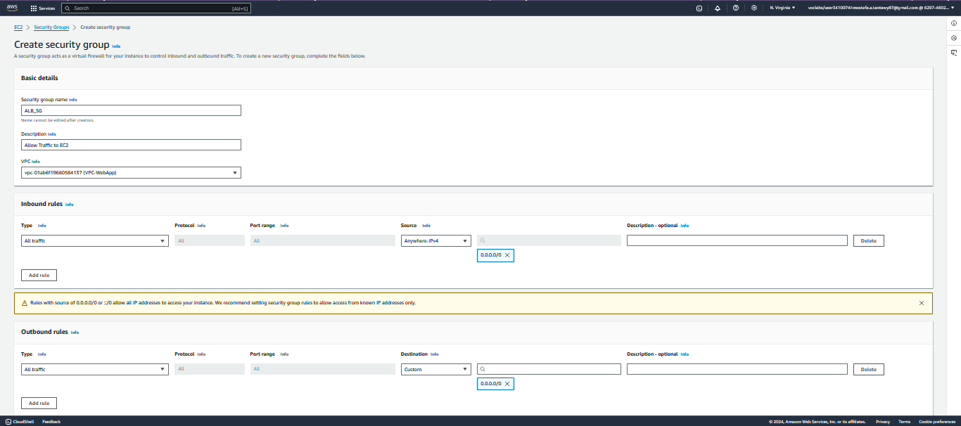
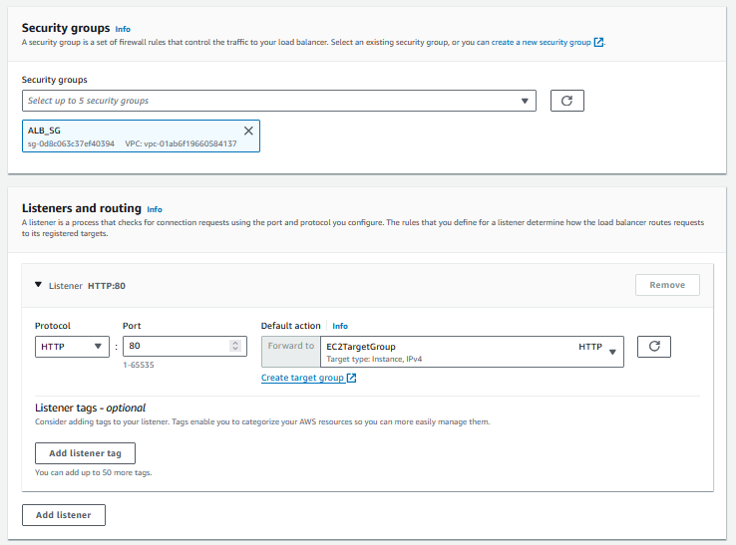
Project Steps
10- Create Security Group For ALB & Listeners

Slide 23
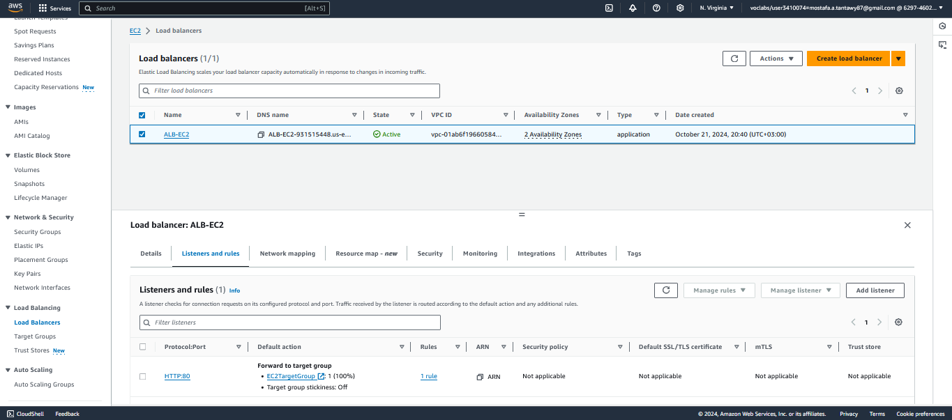
Project Steps
11- Create Application Load Balancer

Slide 24
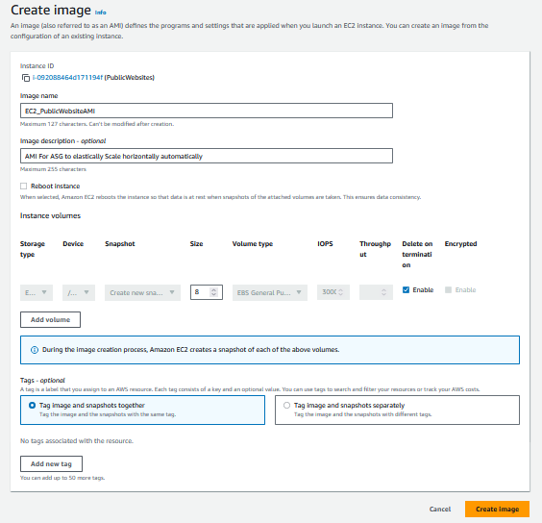
Project Steps
12- Create Image AMI

Slide 25
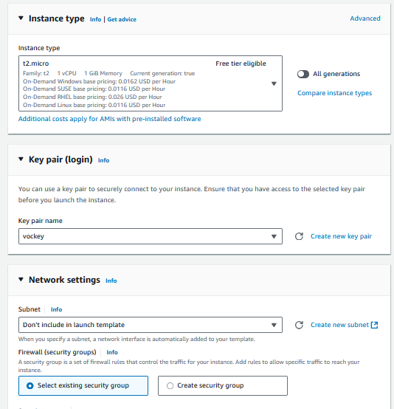
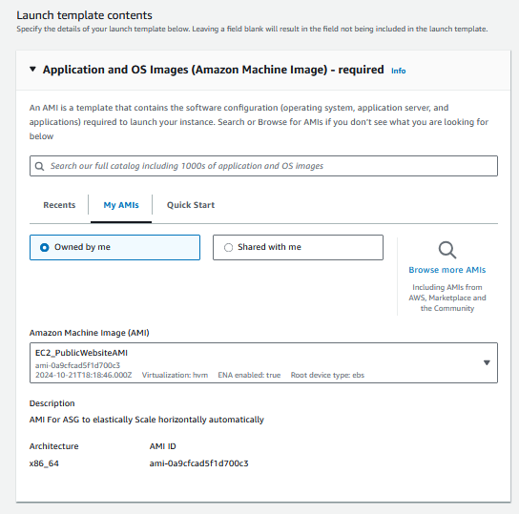
Project Steps
13- Create Launch template

Slide 26
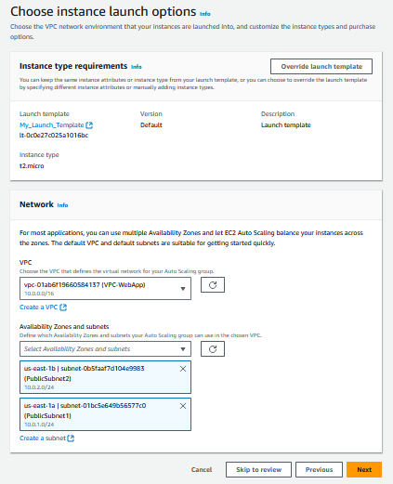
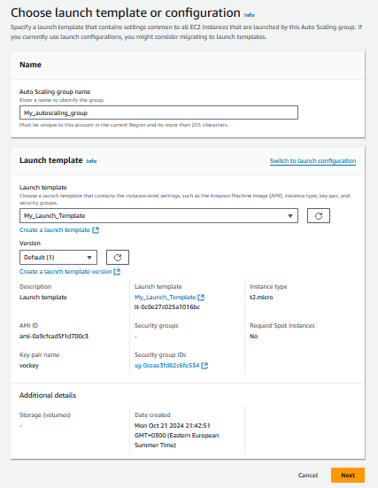
Project Steps
14- Create Autoscaling Group

Slide 27
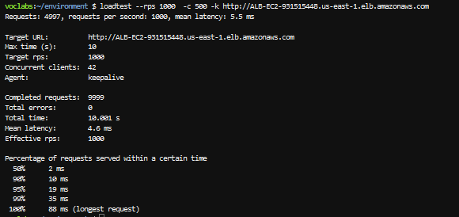
Project Steps
15- Load Test

Slide 28
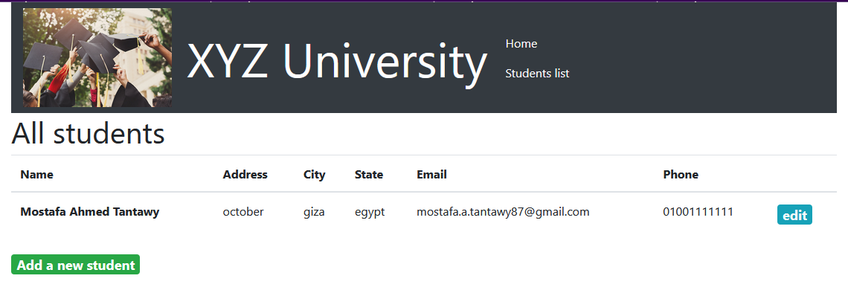
Project Output

Slide 29
Conclusion
Creating an autoscaling group in AWS allows you to automatically manage the number of instances in your infrastructure based on demand. By following the steps outlined in this guide, you can easily create an autoscaling group and ensure that your application can handle varying workloads efficiently.

Slide 30
Thank you

